Slide 1
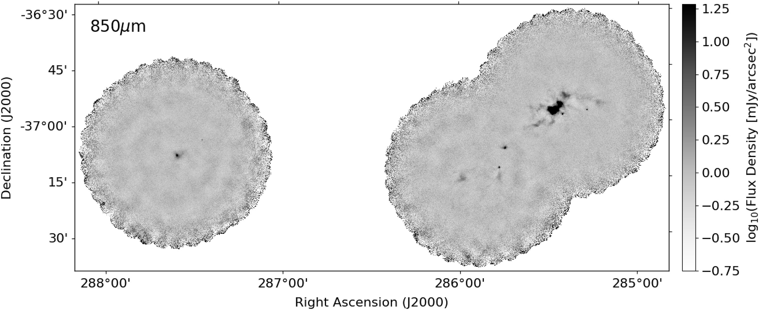
Figure A1. The reduced SCUBA-2 850 $\mu$m flux density map, shown in logarithmic scaling.
Notes:
Figure A1. The reduced SCUBA-2 850 $\mu$m flux density map, shown in logarithmic scaling.
Unless provided in the caption above, the following copyright applies to the content of this slide: © 2025 The Author(s). Published by Oxford University Press on behalf of Royal Astronomical Society.This is an Open Access article distributed under the terms of the Creative Commons Attribution License (https://creativecommons.org/licenses/by/4.0/), which permits unrestricted reuse, distribution, and reproduction in any medium, provided the original work is properly cited.

