Slide 1
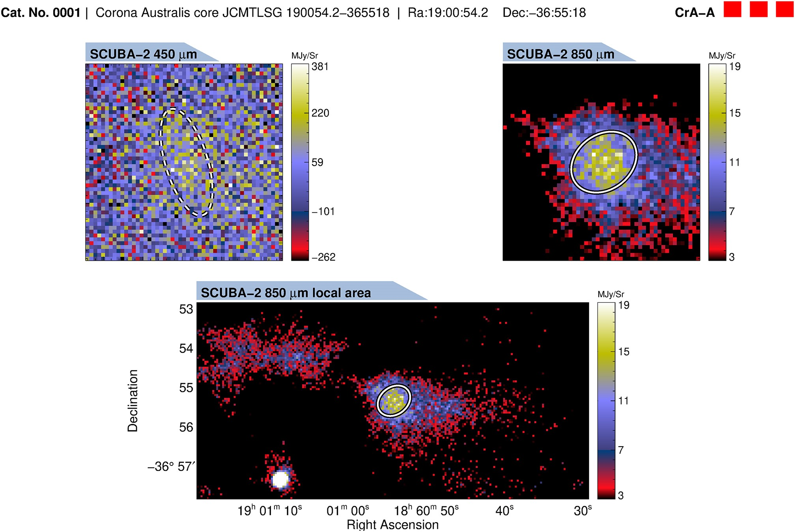
Figure B1. Example getsources output for a starless core. We show SCUBA-2 images at 450 and 850 $\mu$m. We also show a ...
Notes:
Figure B1. Example getsources output for a starless core. We show SCUBA-2 images at 450 and 850 $\mu$m. We also show a local area cut-out using the 850 $\mu$m data. Ellipses represent the estimated major and minor FWHM sizes of the core at each wavelength. If a core is significantly detected at the respective wavelength, the line is solid, and is dashed otherwise. We provide a complete set of these images for our dense cores.
Unless provided in the caption above, the following copyright applies to the content of this slide: © 2025 The Author(s). Published by Oxford University Press on behalf of Royal Astronomical Society.This is an Open Access article distributed under the terms of the Creative Commons Attribution License (https://creativecommons.org/licenses/by/4.0/), which permits unrestricted reuse, distribution, and reproduction in any medium, provided the original work is properly cited.

