Slide 1
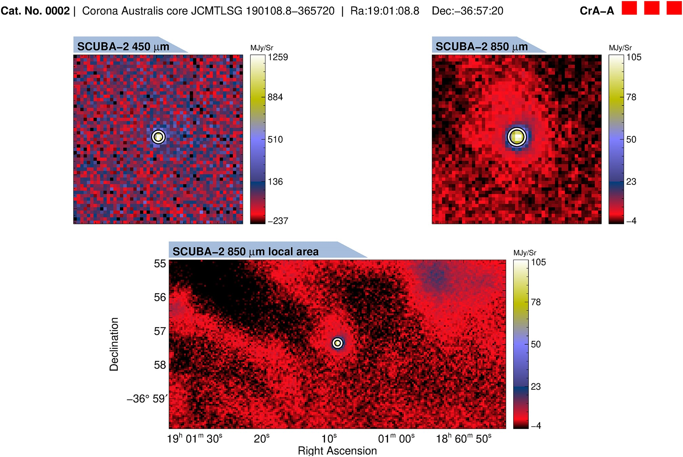
Figure B2. As Fig. B1, but for a protostellar core. The same image cut-outs are shown.
Notes:
Figure B2. As Fig. B1, but for a protostellar core. The same image cut-outs are shown.
Unless provided in the caption above, the following copyright applies to the content of this slide: © 2025 The Author(s). Published by Oxford University Press on behalf of Royal Astronomical Society.This is an Open Access article distributed under the terms of the Creative Commons Attribution License (https://creativecommons.org/licenses/by/4.0/), which permits unrestricted reuse, distribution, and reproduction in any medium, provided the original work is properly cited.

