Slide 1



Slide 2


How old are you on Jupiter?

Slide 3
Earth & Space
Learning Outcome:
To describe the movement of the Earth, and other planets, relative to the Sun in the Solar System

Slide 4
What is at the centre of our Solar System?

Slide 5
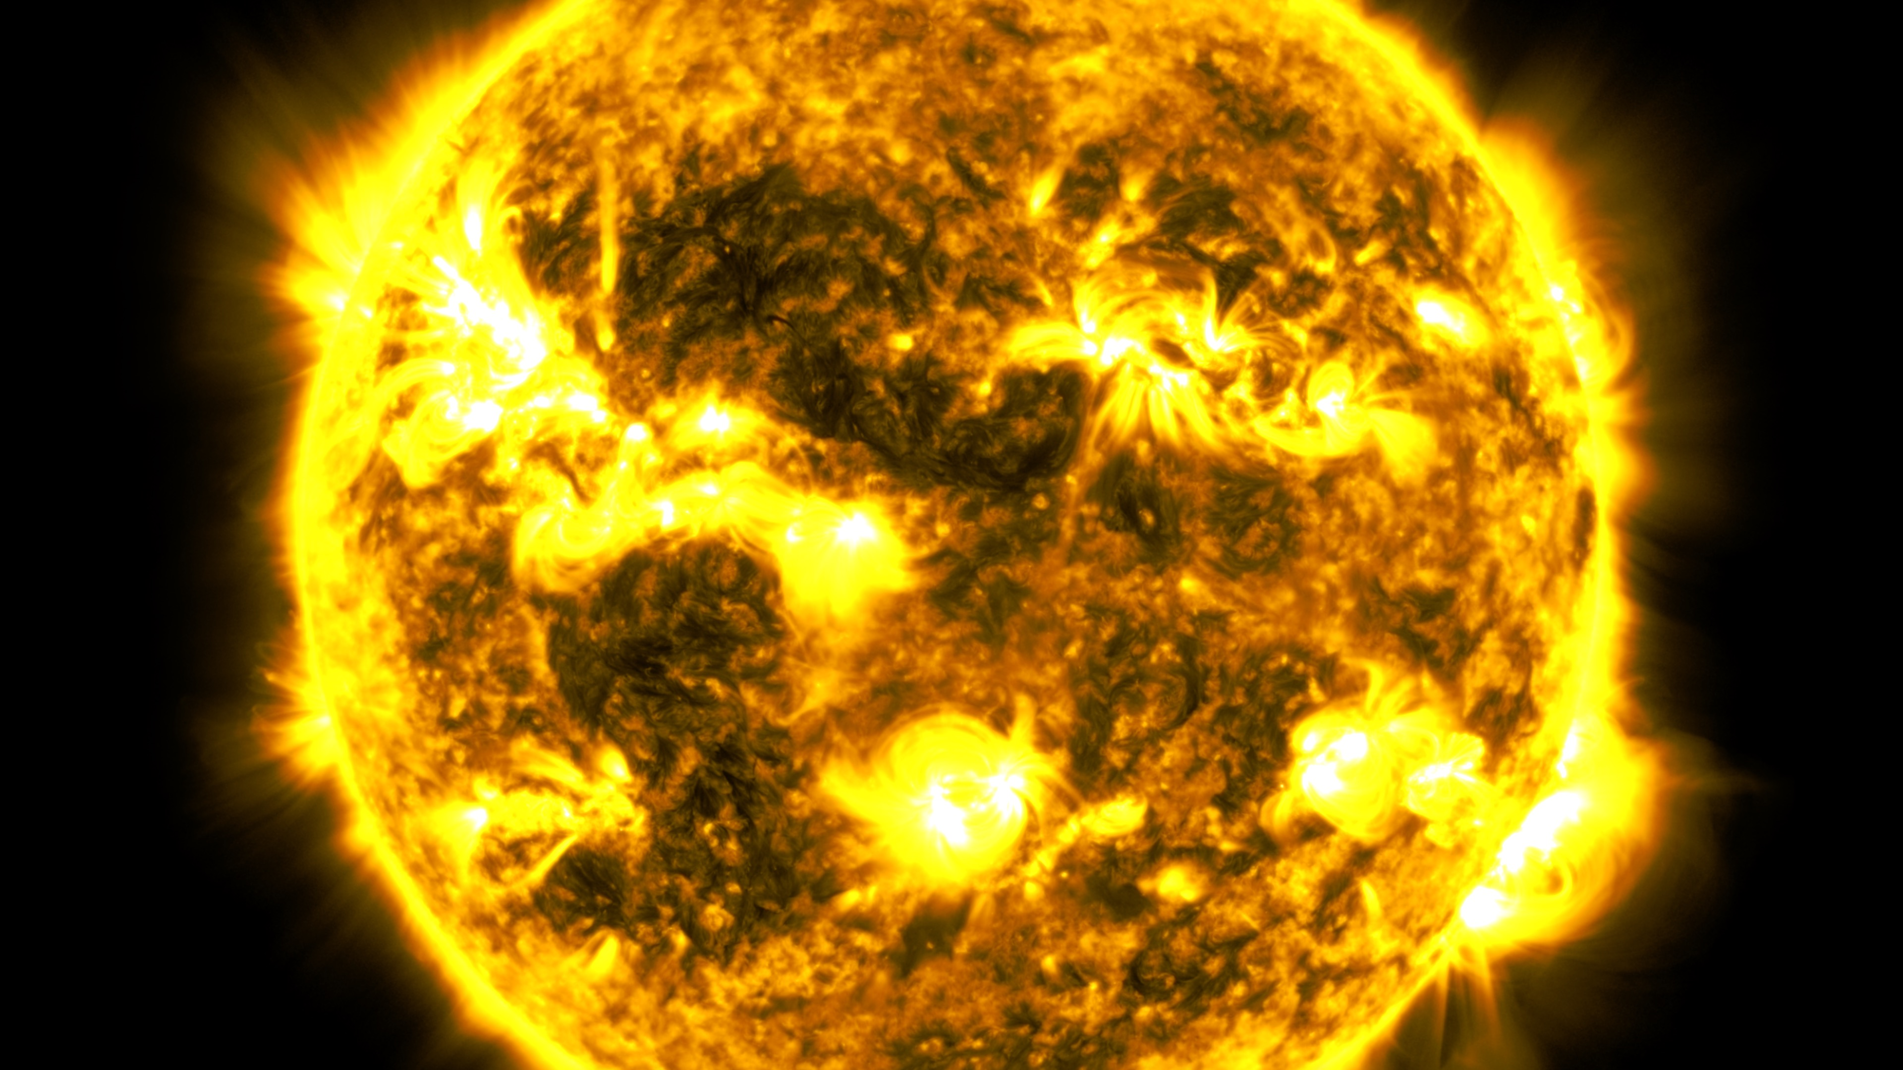
What is at the centre of our Solar System?
The Sun is the star in the middle of our Solar System
All the planets in our Solar System circle around the Sun
Image Credit: NASA/SDO

Slide 6
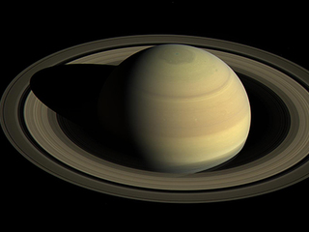
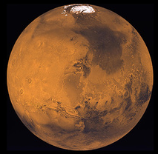
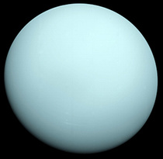
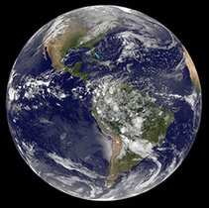
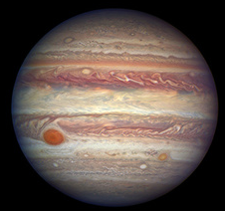
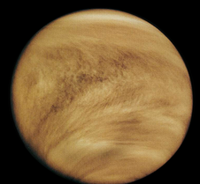
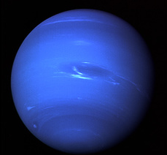
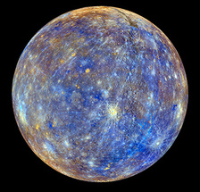
Can you put the planets in order?
Image credit: NASA

Slide 7
Try this pneumonic
My
Very
Excellent
Moves
Jump and
Skip
Under
Neptune

Slide 8
Can you remember the order of the planets?
My = Mercury
Very = Venus
Excellent = Earth
Moves = Mars
Under = Uranus
Neptune
Jump & = Jupiter
Skip = Saturn
Image credit: NASA

Slide 9
What is an Orbit?

Slide 10
What is an Orbit?
An orbit is a circular pathway of one body around another

Slide 11
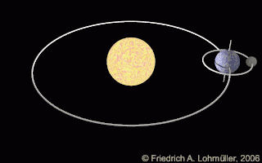
What is an Orbit?
An orbit is a circular pathway of one body around another
The Moon orbits Earth and the Earth orbits the Sun
All the other planets orbit the Sun too

Slide 12
What is a year?

Slide 13
What is a year?
A year is the length of time it takes a planet to orbit the Sun once

Slide 14
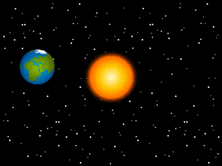
What is a year?
A year is the length of time it takes a planet to orbit the Sun once
Credit: Giphy
It takes Earth 365.25 days to orbit the Sun.
This is why we have a leap year every 4 years

Slide 15
Can you think of some changes on Earth over a year?

Slide 16
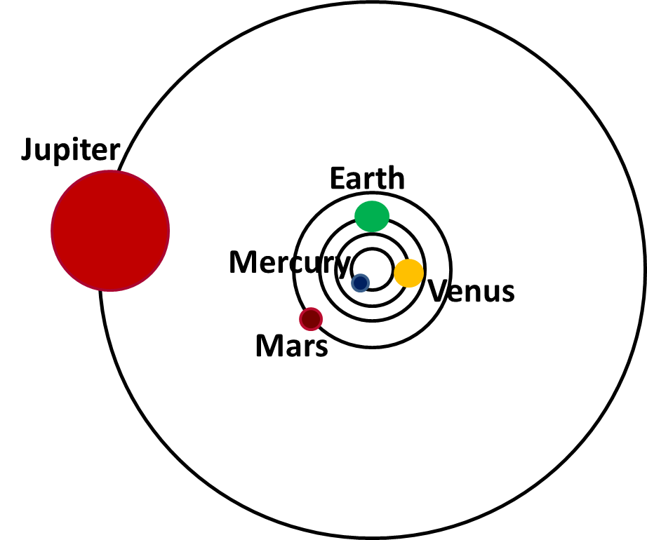
How long is a year on other planets?
Match the orbit time to the correct inner planet
365.25 days
88 days
225 days
12 years
687 days

Slide 17
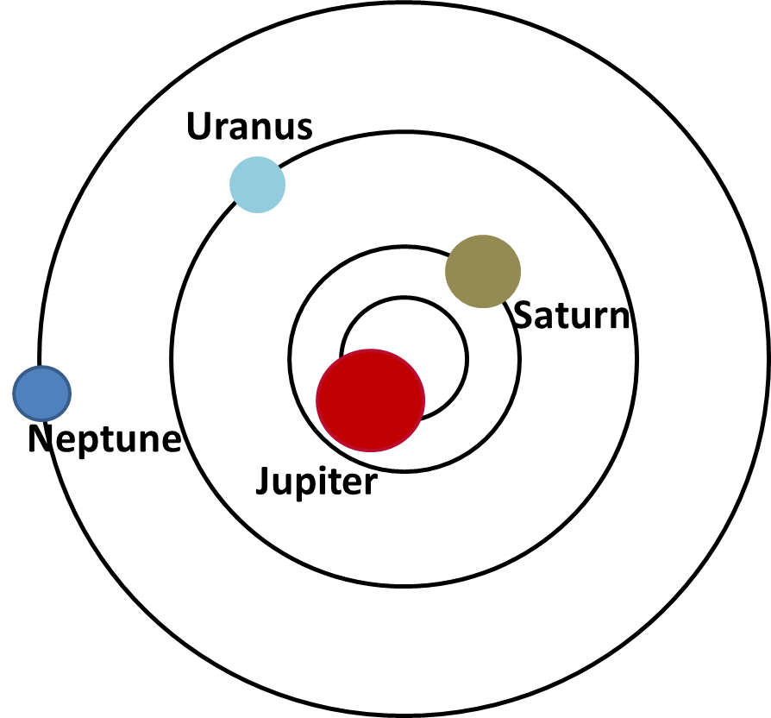
How long is a year on other planets?
Match the orbit time to the correct outer planet
165 years
29 years
12 years
84 years

Slide 18
What do you notice about the length of a year on each planet?
Planet | Orbit Length
Mercury | 88 Earth days
Venus | 225 Earth days
Earth | 365.25 Earth days
Mars | 687 Earth days
Jupiter | 12 Earth years
Saturn | 29 Earth years
Uranus | 84 Earth years
Neptune | 165 Earth years

Slide 19

How old is Lanbot on Mars?
Lanbot the Robot is 9 years and 4 months old.
First:
Work out how old Lanbot is in Earth days.
9 Years = (9 x 365.25 ) = 3287.25 days
4 Months = (4 x 30 ) = 120 days
(we assume 30 days in each month)
Now: Add them together
3287.25 + 120 = 3407.25 days
So Lanbot is 3407.25 Earth days old

Slide 20
How old is Lanbot on Mars?
Lanbot the Robot is 9 years and 4 months old.
Next:
A year on Mars is 687 Earth days
If we divide Lanbot’s age in days, 3407.25 days, by 687 we will find out how old Lanbot would be on Mars.
3407.25 ÷ 687 = 4.96 years
So, Lanbot would be 9.46 years old on Mars.

Slide 21
How old would you be on Mars?
First work out you age in Earth days:
  Number of years x 365.25 =
  Number of months since your birthday x 30 =
Now add the two numbers together,
This is your age in days.
________ + ________ = ________ days

Slide 22
How old would you be on Mars?
Remember, a year on Mars is 687 days
Divide your age in days by 687
Age in Days ÷ 687 = _______________
How old are you on Mars?
On Mars I am _______ years old.

Slide 23
How old are you on Jupiter?
Jupiter takes 12 years to complete one orbit around the Sun

Slide 24

Career Focus:
Catherine Greene
Head of User Centred Design at
Satellite Applications Catapult
Catherine works with customers and her technical team to create a solution to a problem. They use satellites that orbit the Earth and look down at the Earth, not up at the Sky!
“We create new products and services that we hope will improve lives. For example, using satellites to show a local council where pollution is running into rivers can help them stop it happening”

