Slide 1



Slide 2


How do we know the Earth is a sphere?

Slide 3
Earth & Space
Learning Outcome:
Describe the Sun, Earth and Moon as approximately spherical bodies

Slide 4
What is the difference between a flat circle and a sphere?

Slide 5



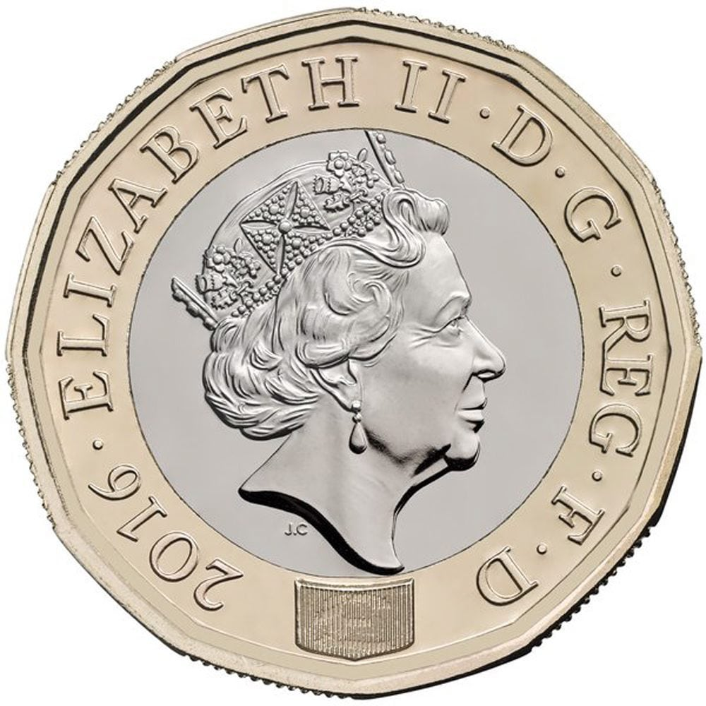
Which of these objects are flat and which are a sphere?
Flat
Sphere
Can you think of any other objects?

Slide 6
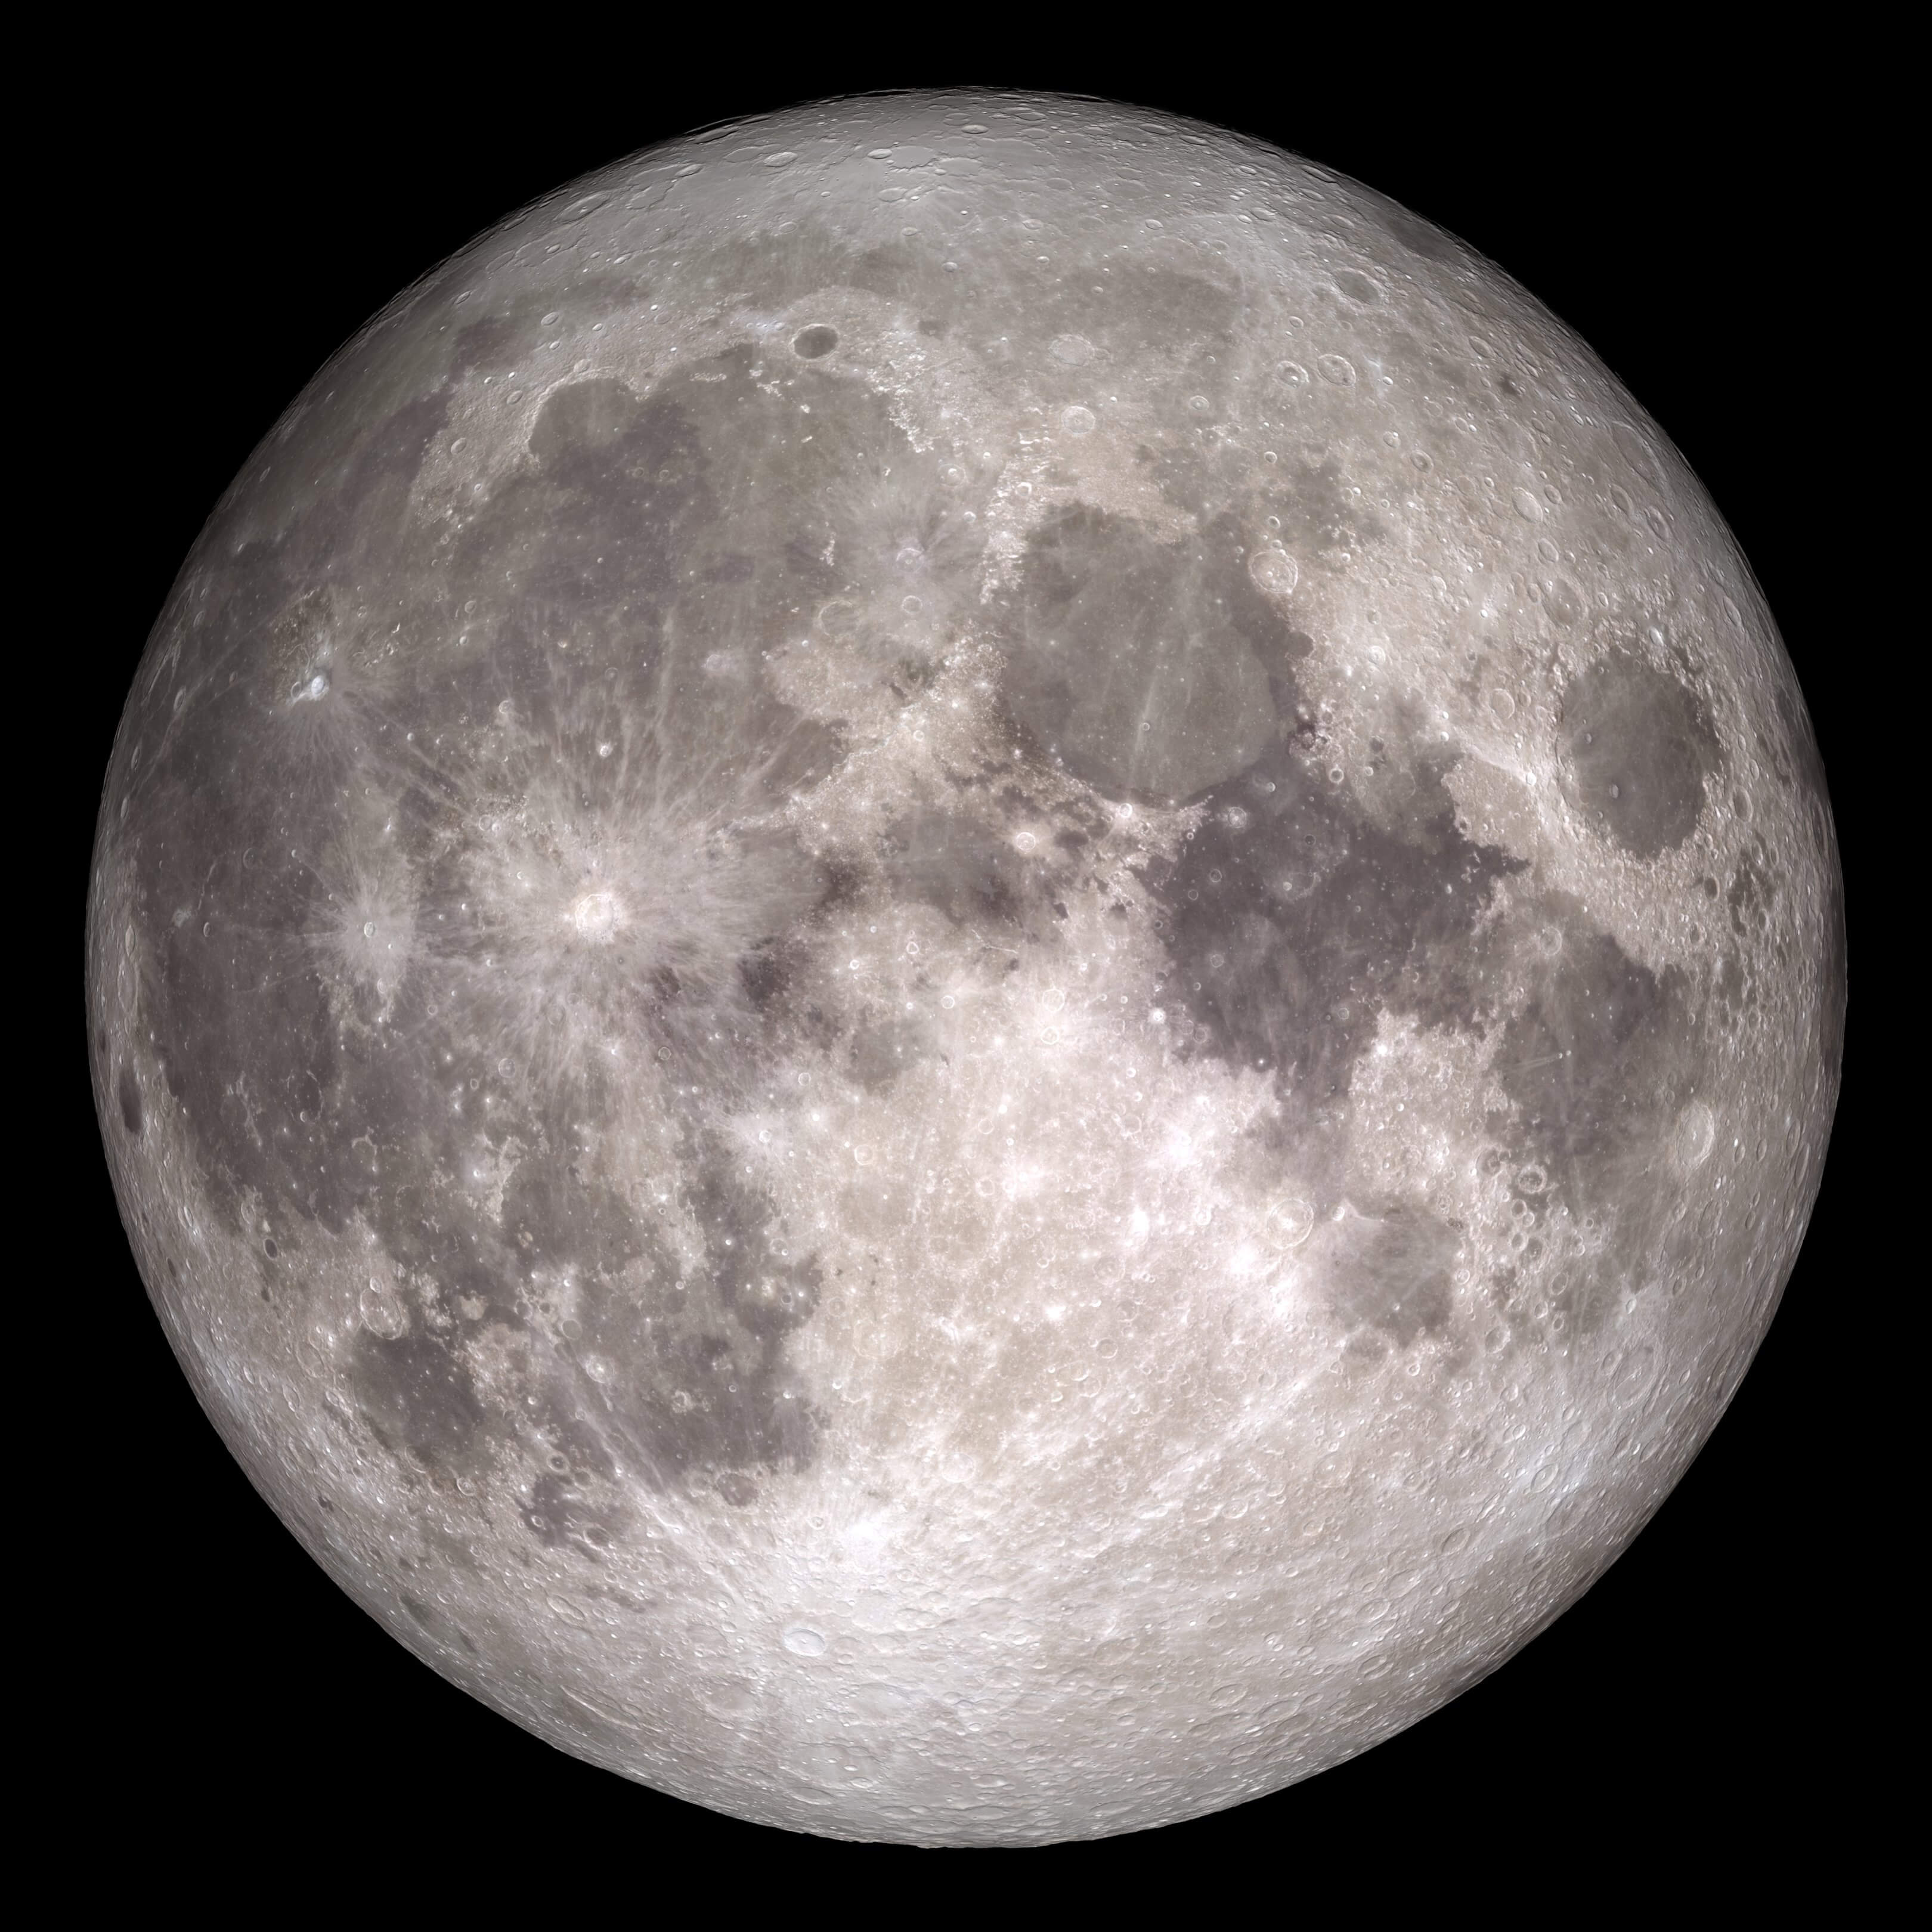
Do you think the Moon is flat or spherical?
This is what we see from Earth
This is what the Apollo astronauts saw:
Data from the Lunar Reconnaissance Orbiter
Data from the Lunar Reconnaissance Orbiter
Credits: Data Visualization by: Ernie Wright (USRA) Video Produced & Edited by: David Ladd (USRA) Music provided by Universal Production Music: "Visions of Grandeur" - Frederick Wiedmann
Image Credit: NASA/Goddard Space Flight Center/ Arizona State University. Taken with the Lunar Reconnaissance Orbiter spacecraft.
Notes:
Link to video: https://svs.gsfc.nasa.gov/13537

Slide 7
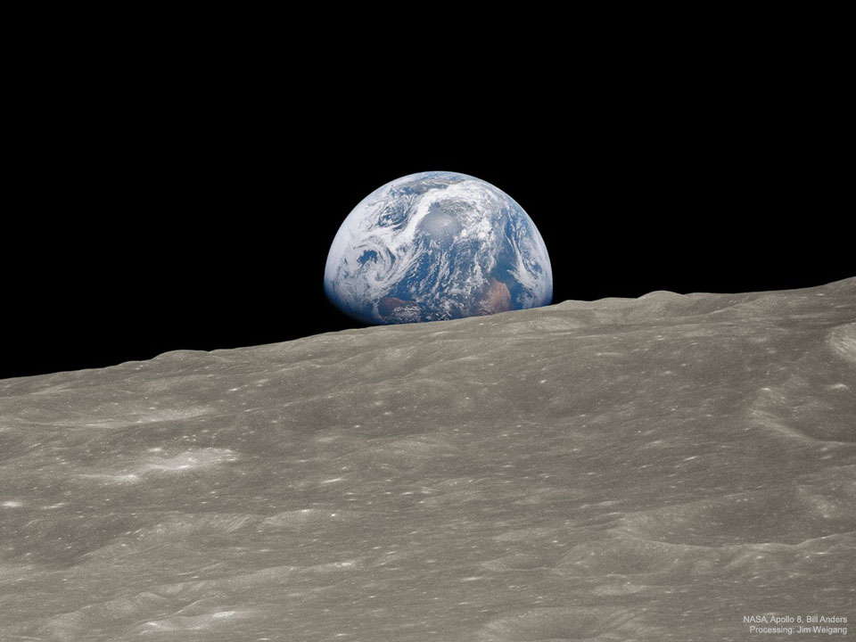
Is the Earth flat?
This is how the astronauts of Apollo 8 saw the Earth from the Moon.
Image Credit: NASA, Apollo 8 Crew, Bill Anders; Processing and License: Jim Weigang

Slide 8
Evidence for a spherical Earth (before space missions)
Can you think of any other evidence that the Earth is a sphere?
Maybe think about the stars moving in the night sky.

Slide 9
Experiment Time: If the Earth was flat
Put your object (e.g. toy car) on the flat table in front of you. Sketch what you see in box 1.
Move your object half-way along the table away from you. Sketch what you see in box 2.
Move your object to the other side of the table. Sketch what you see in box 3.
1.
2.
3.
What happens to the size of the object? What bits of the object can you see? Is this the same in boxes 1, 2 and 3?

Slide 10
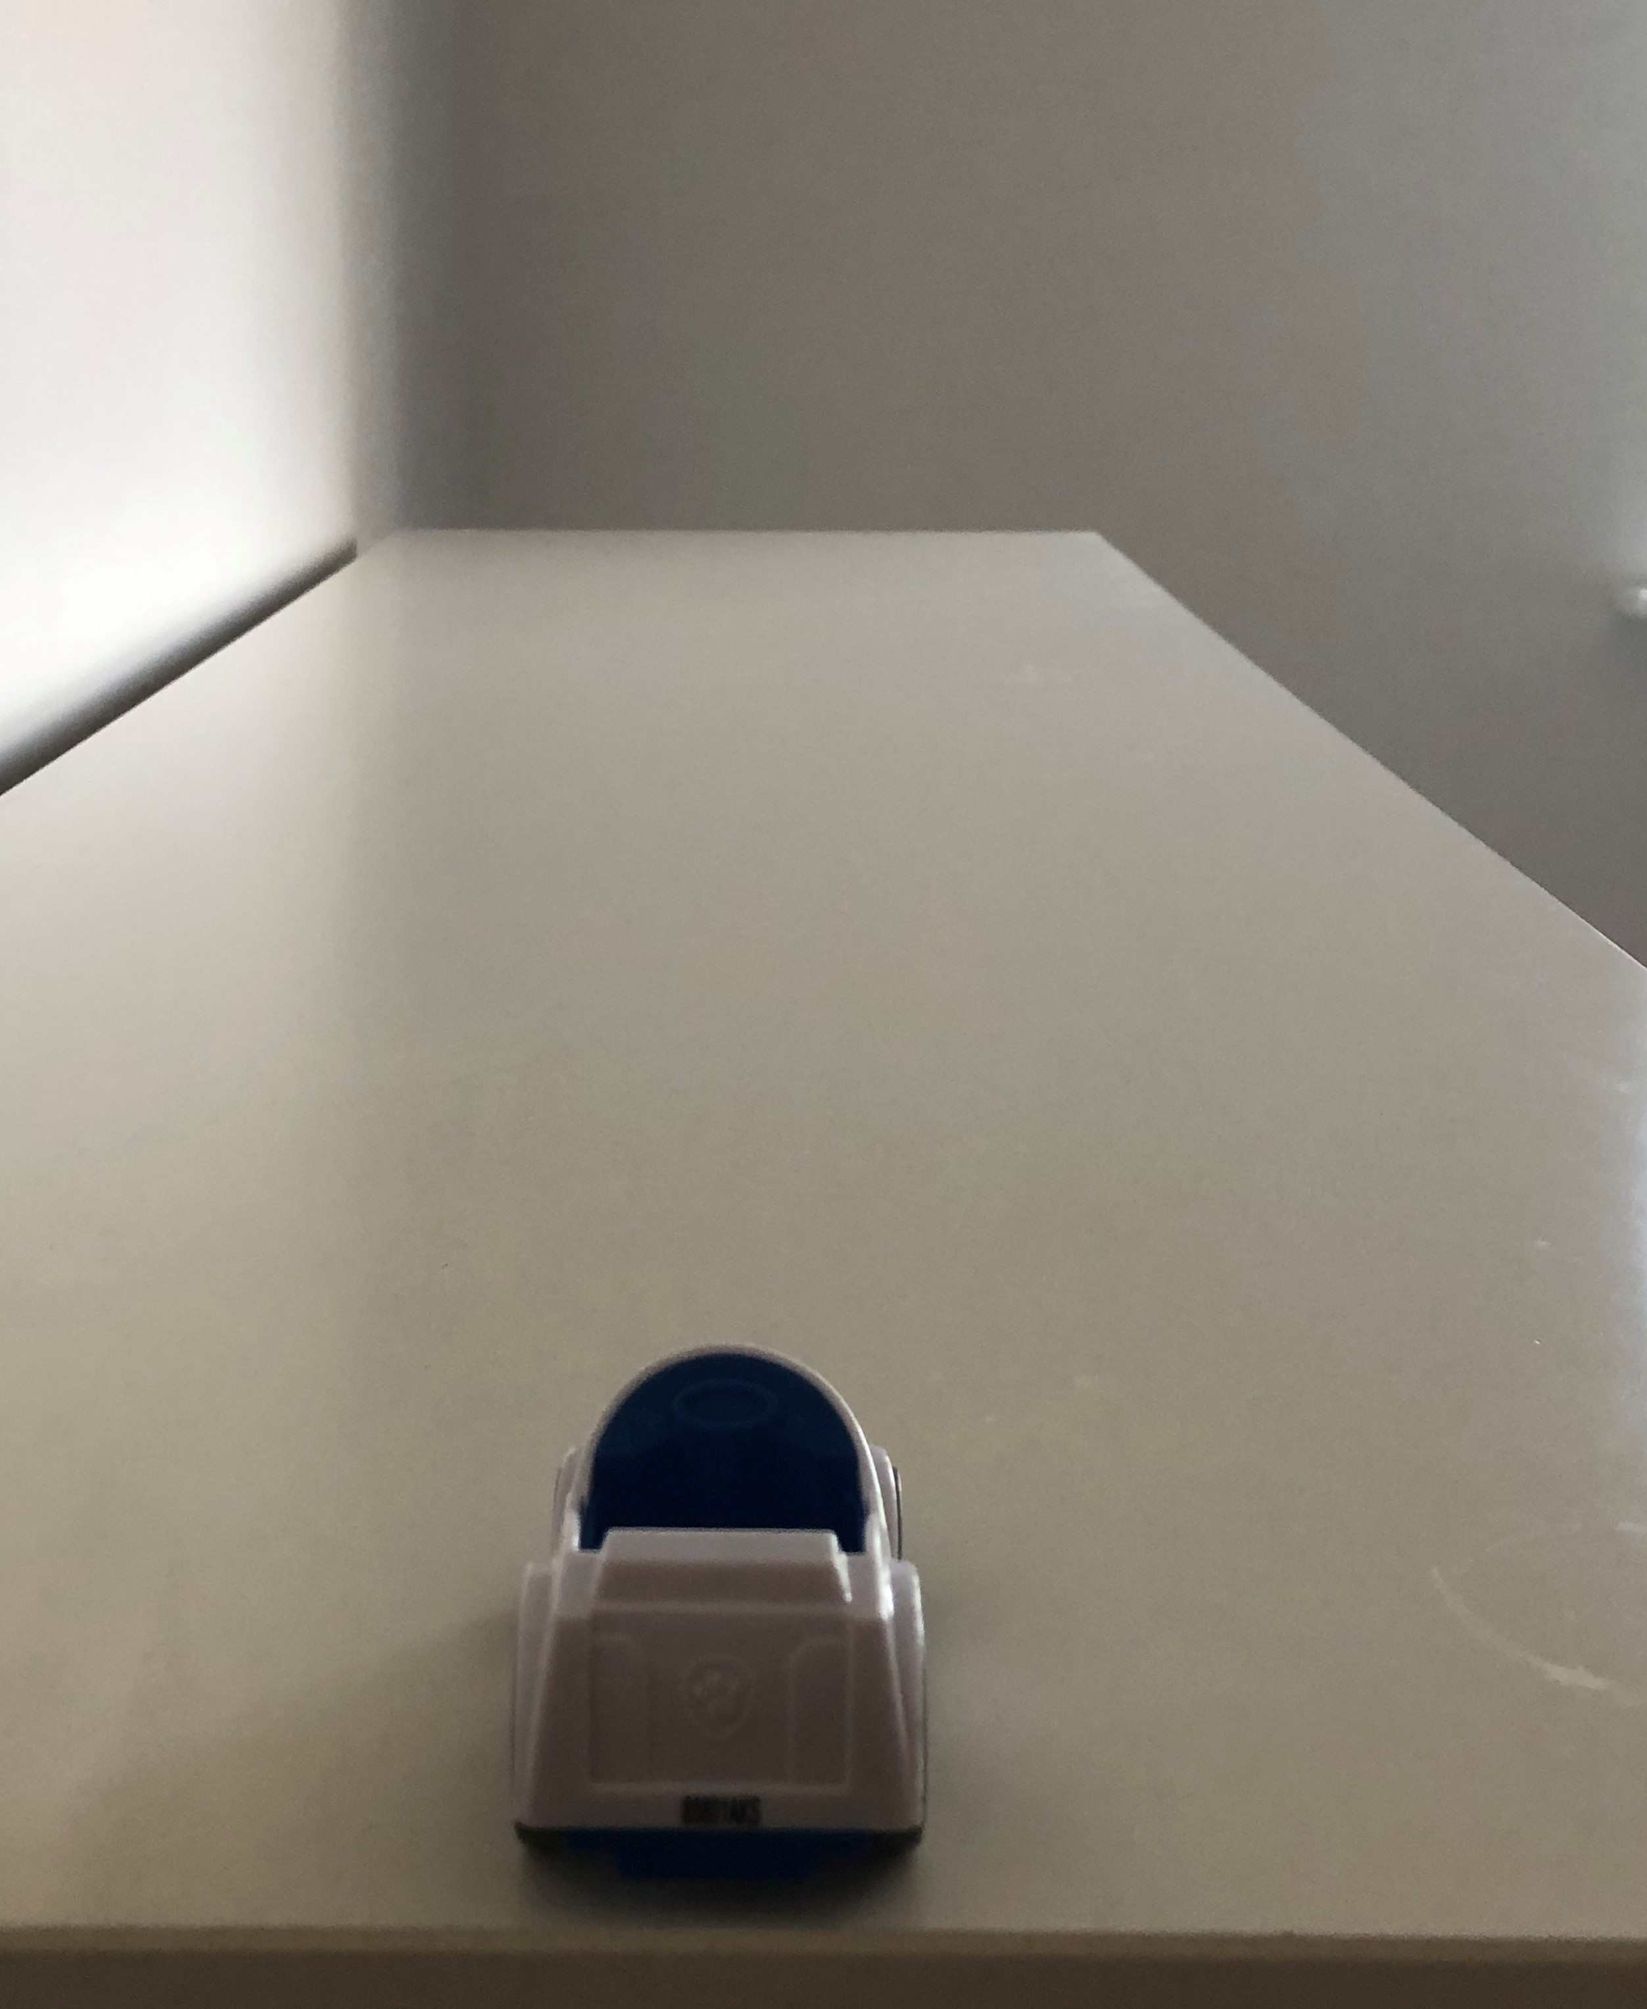
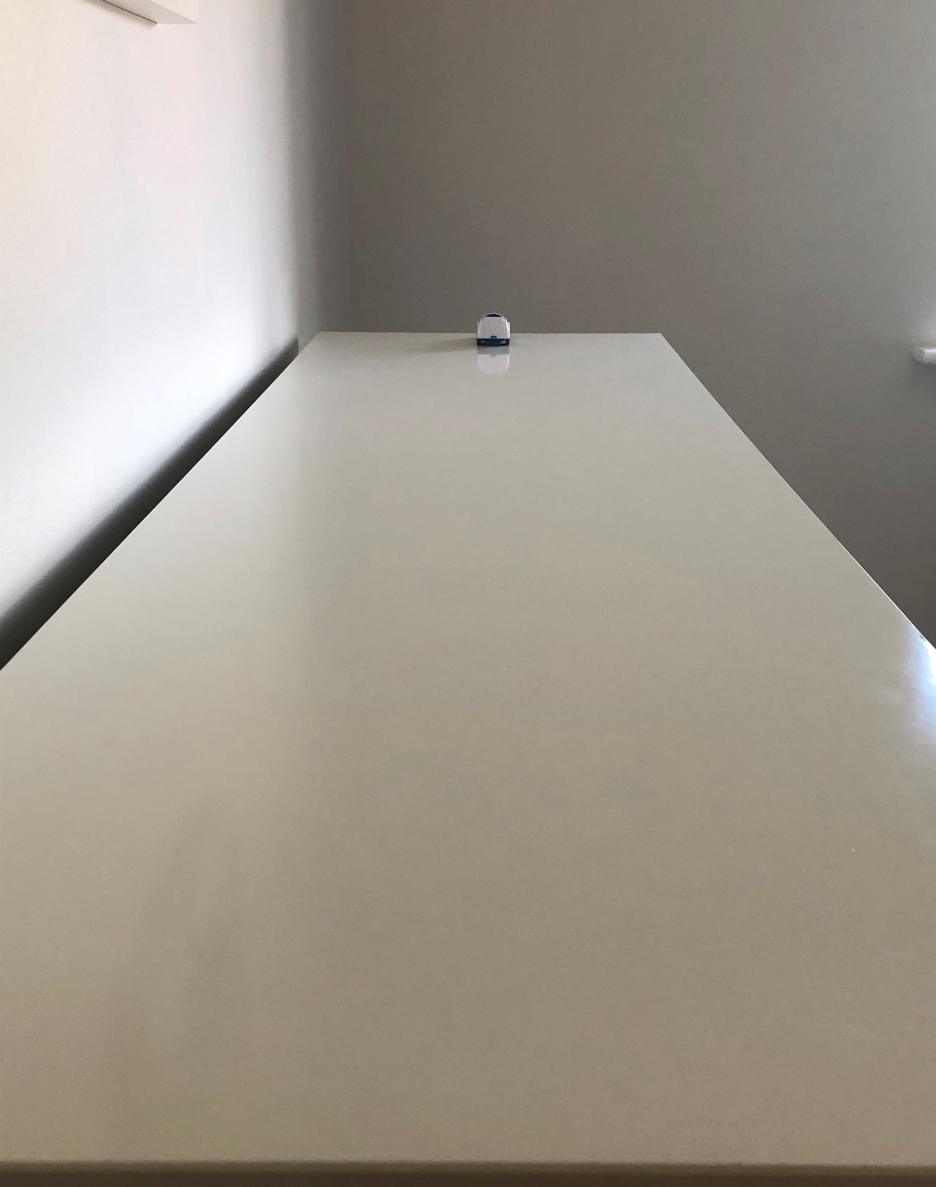
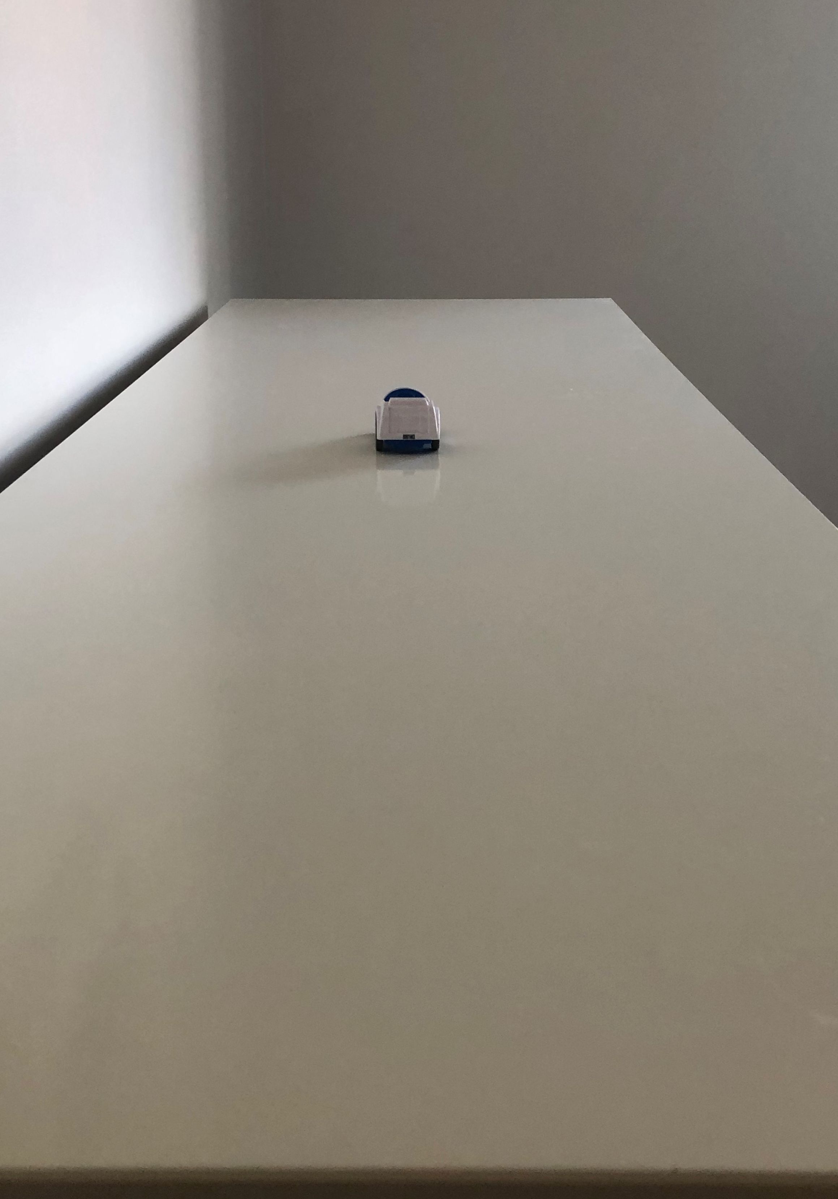
Answers: What do you see if the Earth is flat?
As you move the toy away, what do you see?
1.
2.
3.
The toy car gets smaller and smaller the further away it gets.
But we can still see all of the car.

Slide 11
Experiment Time: If the Earth was a sphere
Put your object (e.g. toy car) on top of the ball. Sketch what you see in box 1.
Move your object away from you, so it is going over the edge of the ball. Sketch what you see in box 2.
Move your object further round the ball, moving away from you. Sketch what you see in box 3.
1.
2.
3.
What happens to the size of the object? What bits of the object can you see? Is this the same in boxes 1, 2 and 3?

Slide 12
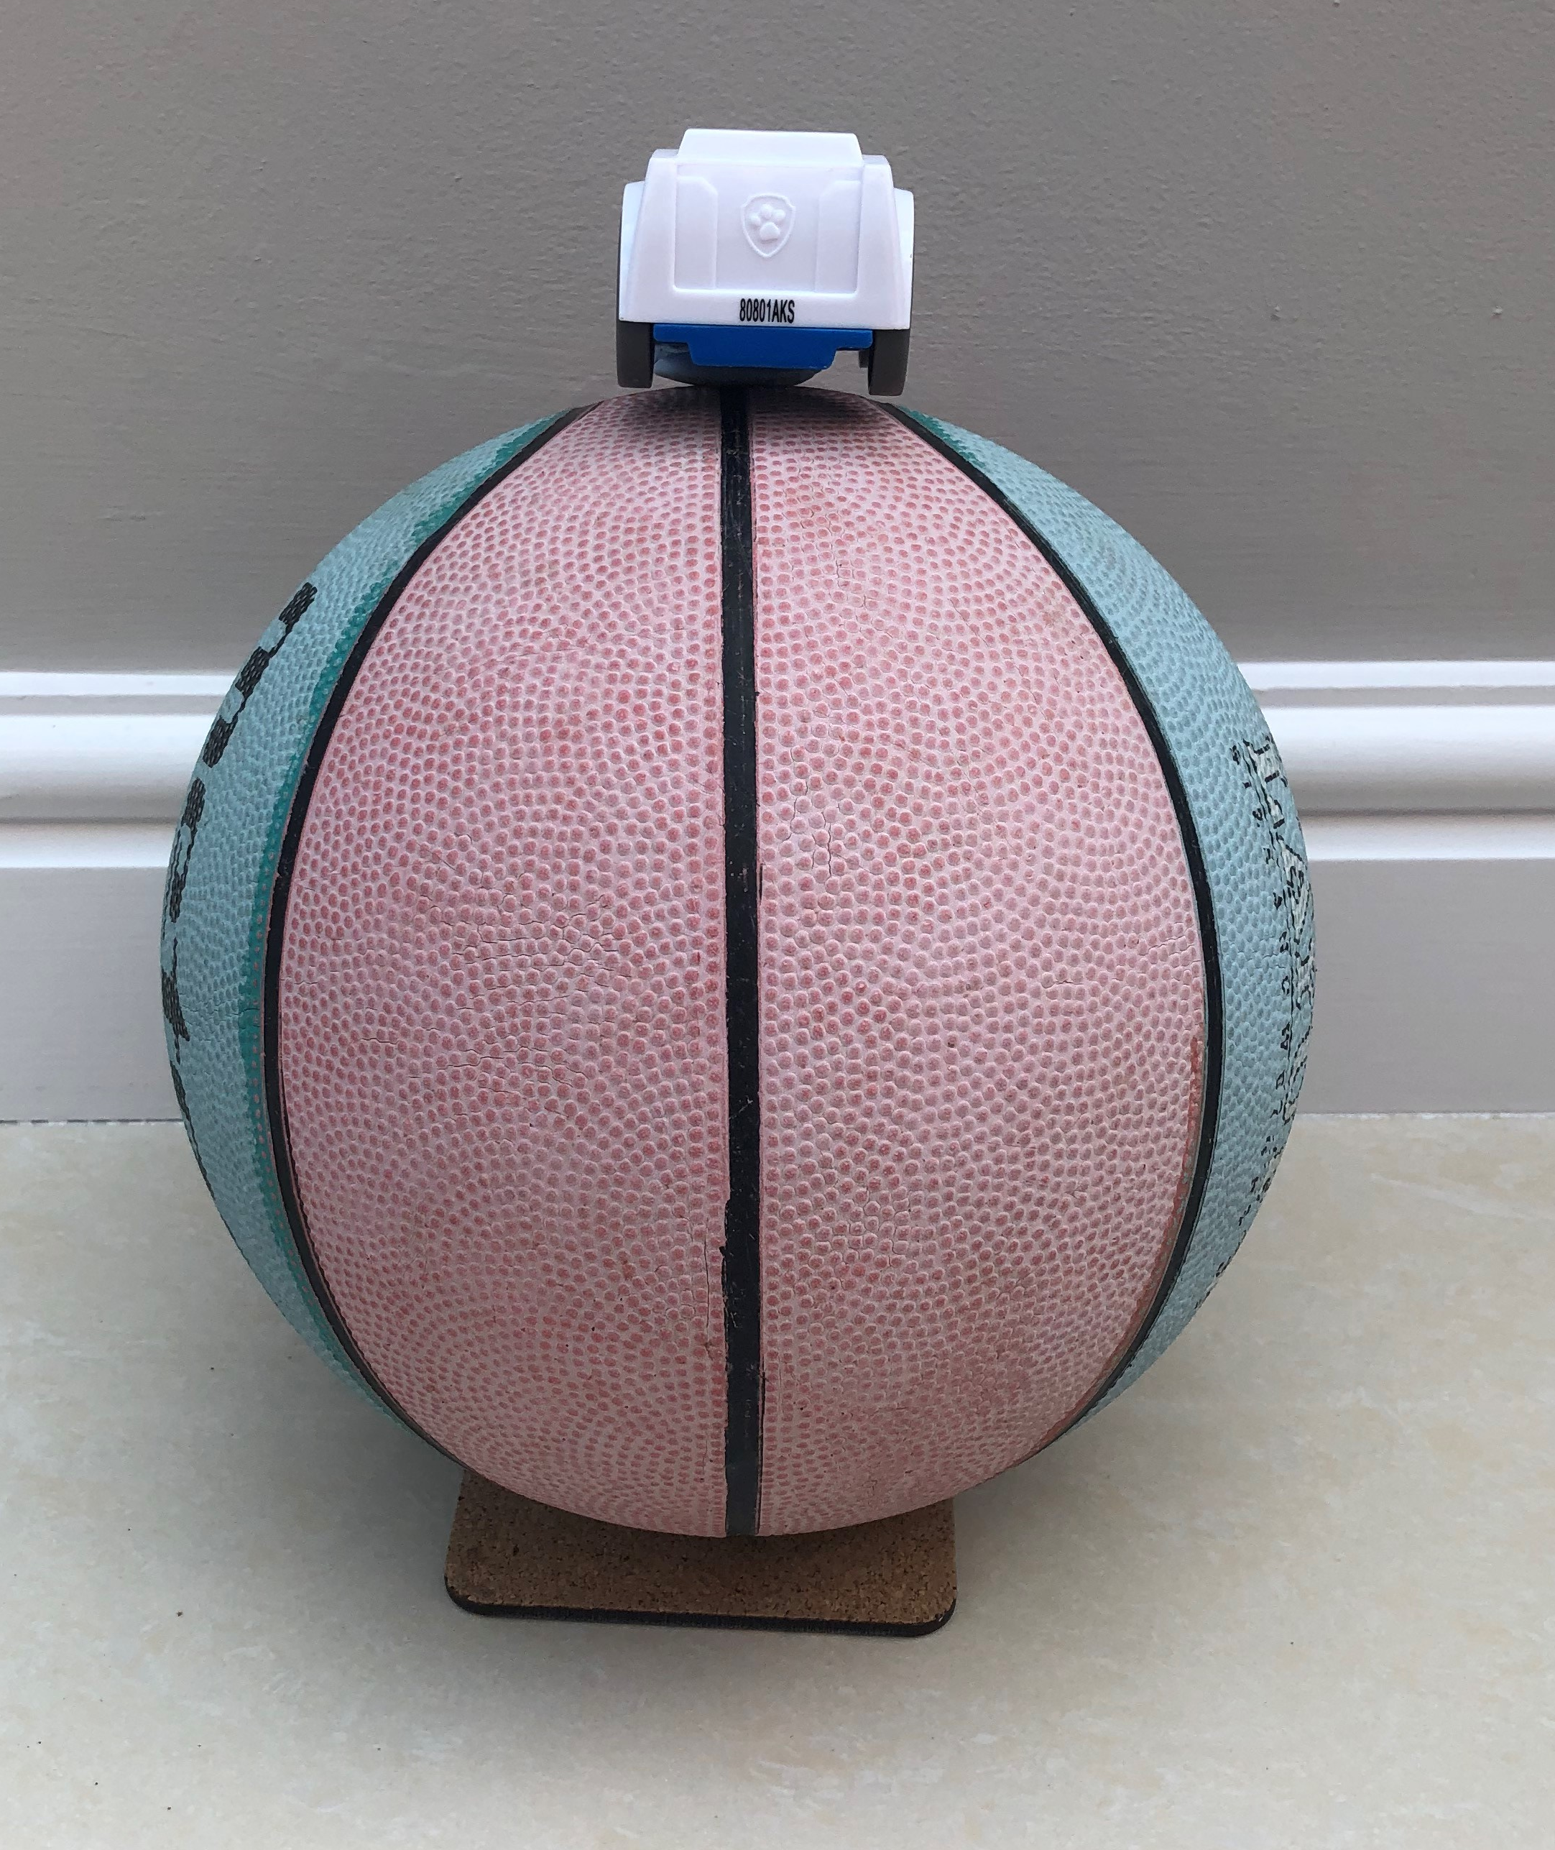
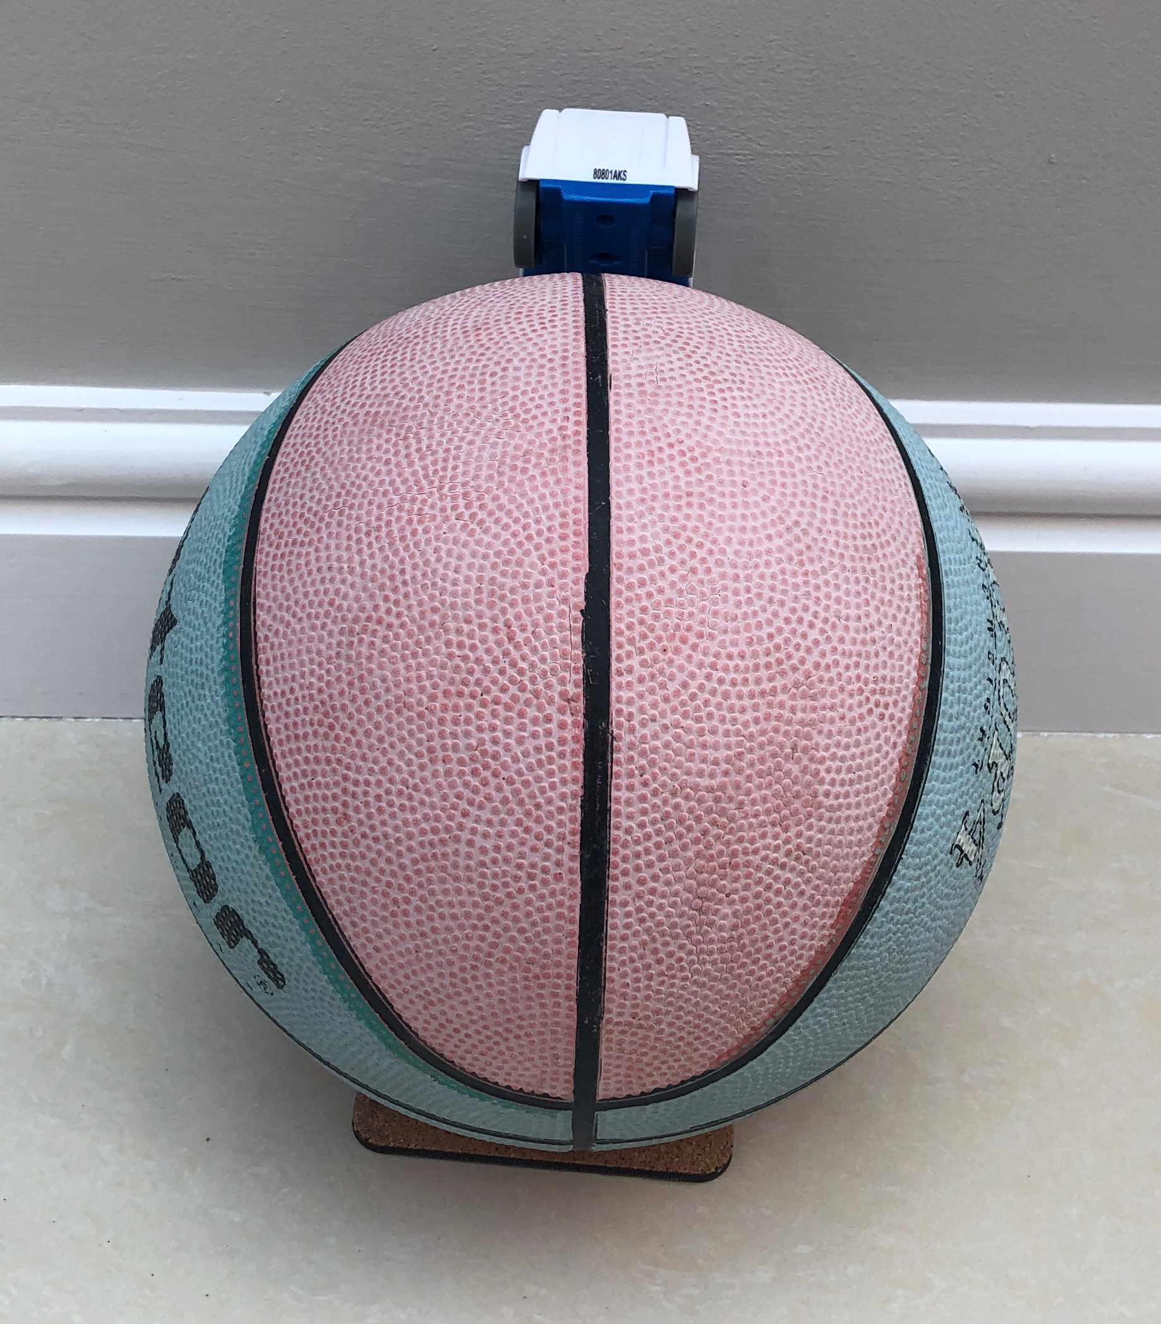
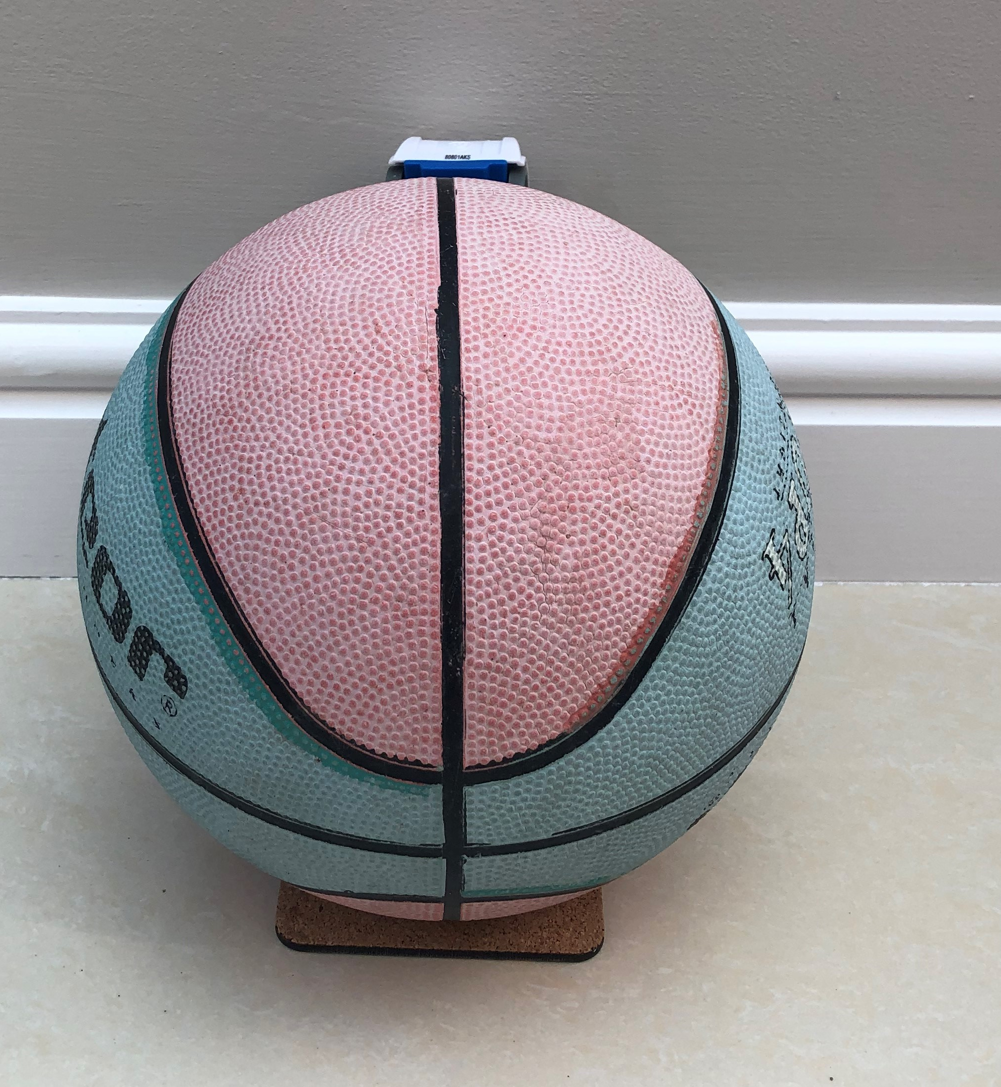
Answers: What do you see if Earth is spherical?
As you move the toy away from you, around the ball, what do you see?
1.
2.
3.
You start to see the car disappear; you see less of the car.

Slide 13
Stars move across the night sky in an arc and so do satellites. This is because they are following a circular path around spherical Earth.
Why don’t you use Stellarium to see satellite and star tracks around Earth.
Notes:
https://stellarium.org/ is a free software which can be downloaded on a phone or laptop/pc.
Don’t forget to look at our career cards as we have people who work on satellites on them!

Slide 14

Career Focus:
Amber Fitzpatrick
Power Systems Graduate Engineer.
“I investigate creative and innovative ways space crafts can generate and deliver power.”
As a graduate engineer, Amber is still learning all about how to deliver power to our homes on Earth, and how to power space crafts.

