Slide 1



Slide 2


Why do we get day and night?

Slide 3
Earth & Space
Learning Outcome:
Use the idea of Earth’s rotation to explain day and night and the apparent movement of the Sun across the sky.

Slide 4
How does the Earth spin on its axis?

Slide 5
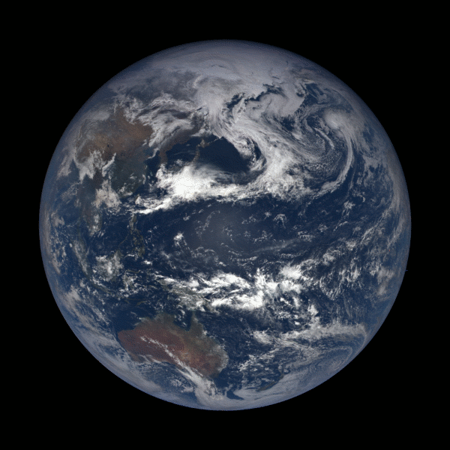
The Earth rotates on its axis once in 24 hours
Tilt = 23.5 degrees
Image Credit: NOAA/NASA EPIC Team

Slide 6
Day and Night
The Sun shines on half of the Earth at any one time.
This is when it is daytime.
Day
Night
It is nighttime on the side of the Earth facing away from the Sun.

Slide 7
Sunrise and Sunset
As Earth rotates, the parts of the Earth in darkness come into the light. This is sunrise.
Day
Night
As Earth rotates, the parts of the Earth in the light head into darkness. This is sunset

Slide 8
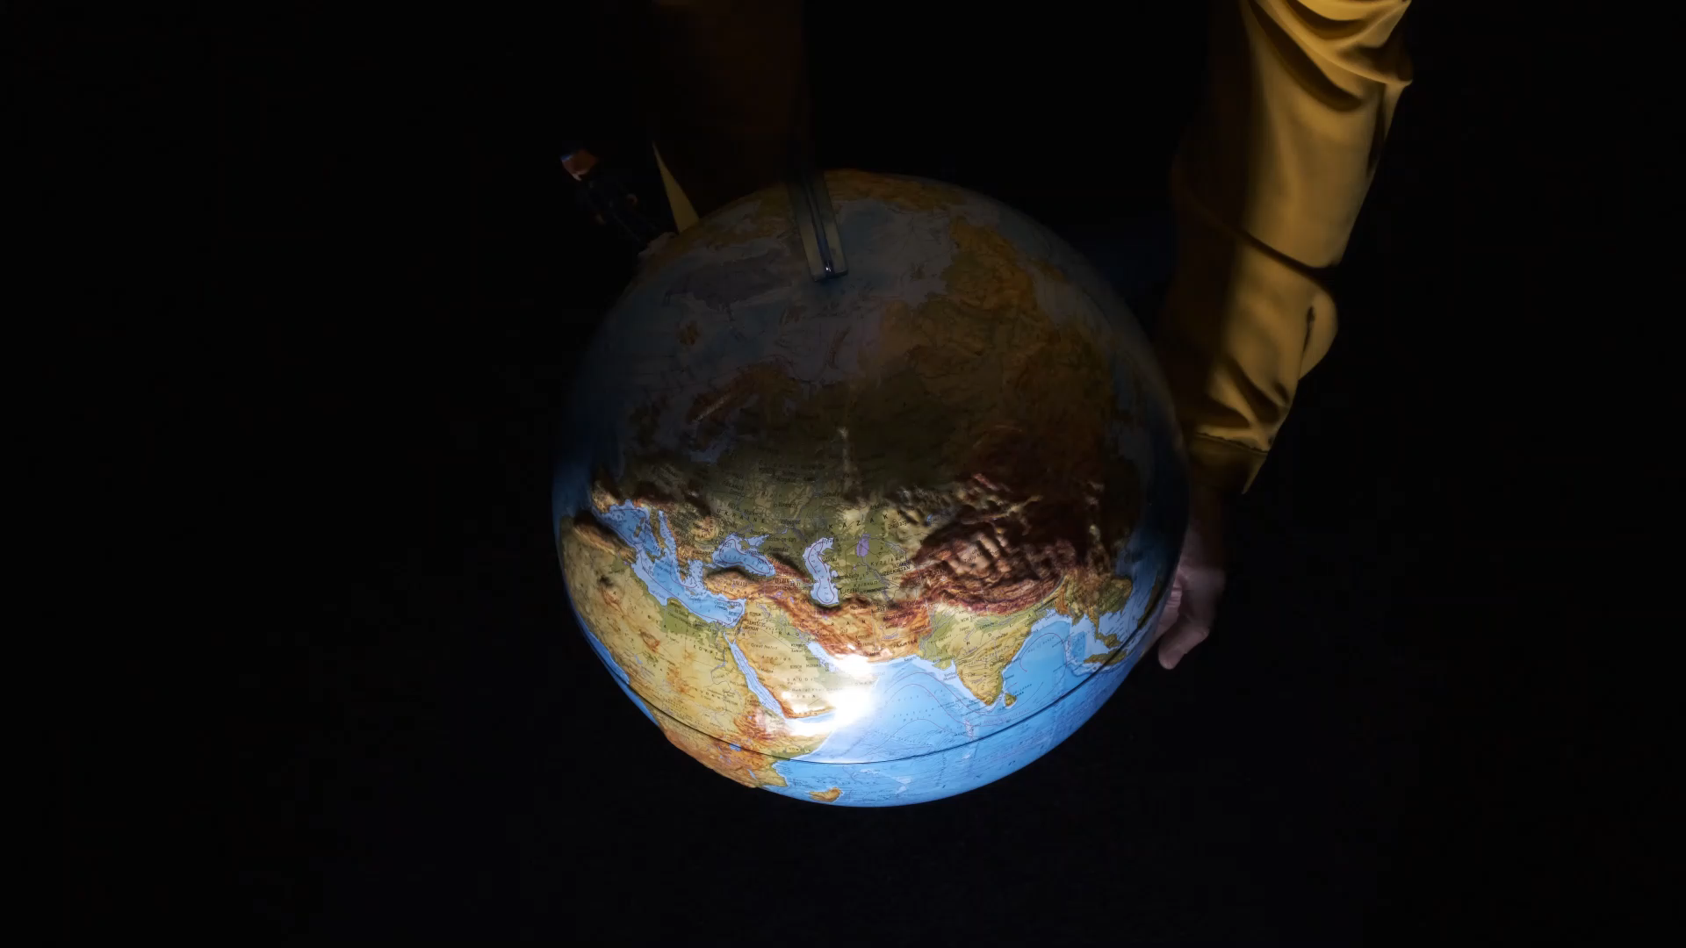
Anti-clockwise Rotation
Because the Earth rotates anti-clockwise, the sunrises in the East, and sets in the West

Slide 9
Anti-clockwise Rotation
Because the Earth rotates anti-clockwise, the sunrises in the East, and sets in the West
Earth’s rotation, it means that when it is daytime for us it is nighttime in countries on the opposite side of the Earth.
Each city sees a different amount of sunlight depending on the rotation of the Earth.

Slide 10
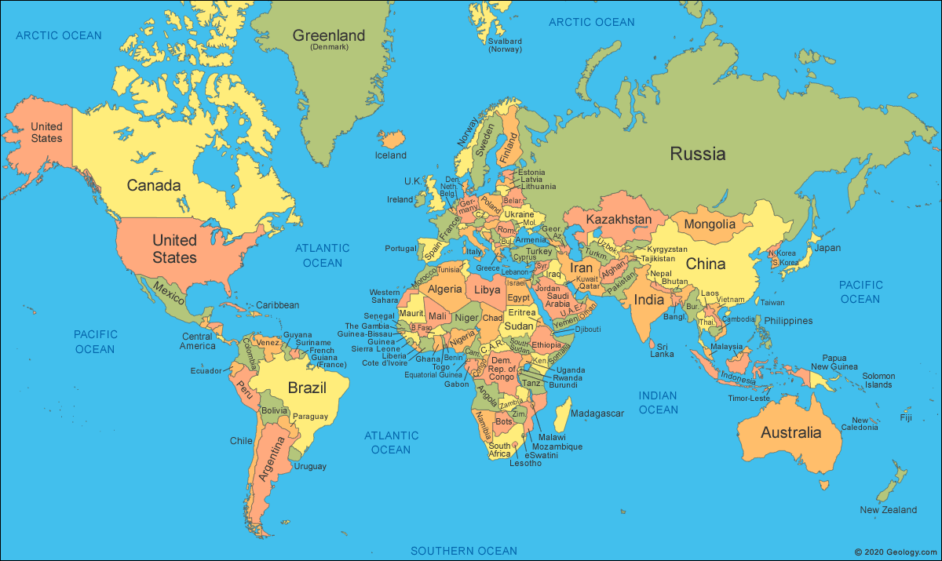
Time Zones
Day and night is why different countries have different time zones.
Otherwise 11am would be in the daytime in one place and nighttime in another.
N
UK: 5pm
New York: 11am
W
E
S
Sydney: 1am

Slide 11
Look at a globe or a map.
Can you find pairs of countries where it is daytime in one place and night time in another?

Slide 12

Career Focus:
Mirko Viviano
Electrical Systems Engineer.
“My job is to design and build the electrical parts of satellites”
The satellites Mirko help build orbit Earth and give us GPS or internet. These satellites are in a geostationary orbit, which means they are always above the same point on Earth no matter what time day or night it is.

