Slide 1



Slide 2


How does the length of a shadow change over one day?

Slide 3
Earth & Space
Learning Outcome:
Use the idea of Earth’s rotation to explain day and night and the apparent movement of the Sun across the sky.

Slide 4
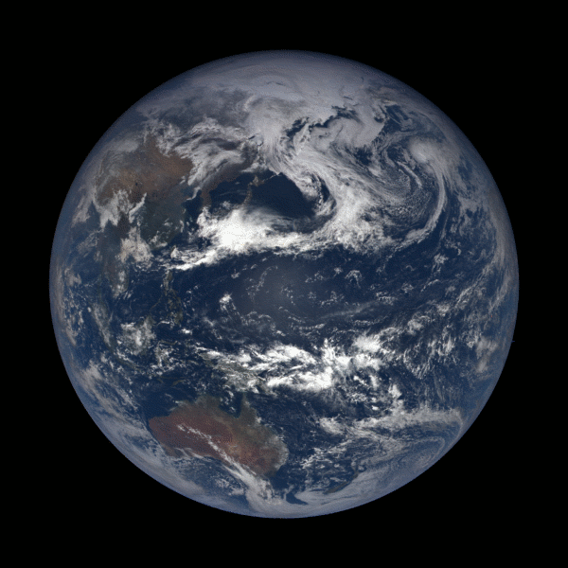
The Earth rotates on its axis once in 24 hours
Image Credit: NOAA/NASA EPIC Team

Slide 5
Sunrise and Sunset
As Earth rotates, the parts of the Earth in darkness come into the light. This is sunrise.
Day
Night
As Earth rotates, the parts of the Earth in the light head into darkness. This is sunset.

Slide 6
Sunrise and Sunset
The Sun rises in the East.
The Sun sets in the West.
This is due to the anti-clockwise rotation
of the Earth.
Day
Night
How does the Sun move across the sky during the day?

Slide 7

How does Lanbot see the Sun move from Earth?
Midday
Sunset
Sunrise
West
East

Slide 8
How does Lanbot see the Sun move from Earth?
Midday
They see the Sun move across the sky, even though it is Earth that is rotating.
Sunset
Sunrise
West
East

Slide 9
How does Lanbot see the Sun move from Earth?
Midday
12pm
2pm
10am
4pm
8am
Use your figure, torch and rules to investigate how the length of the shadow changes over time.
6pm
6am
Sunset
Sunrise
West
East

Slide 10
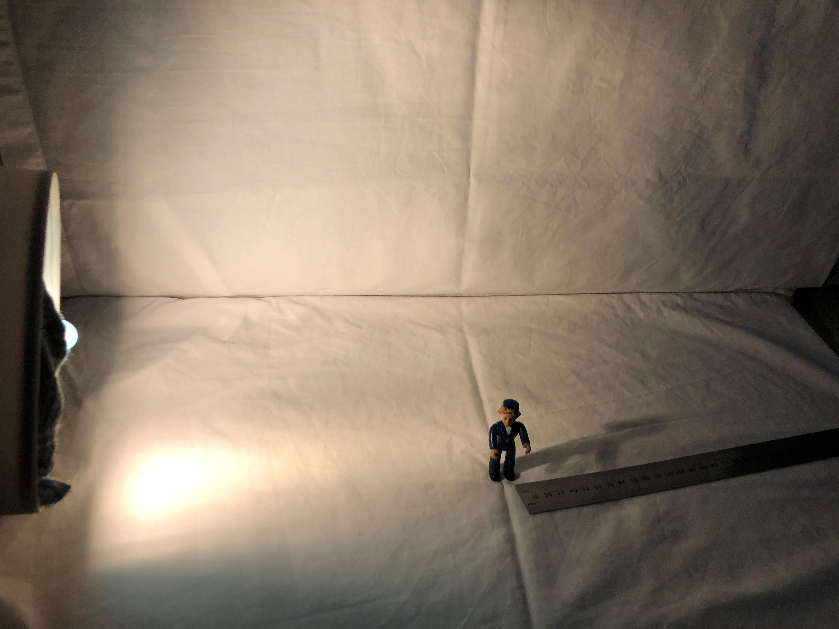
At sunrise (6am)
Place your torch at one side, level with the floor or table
Use your ruler to measure the length of the shadow
6am

Slide 11
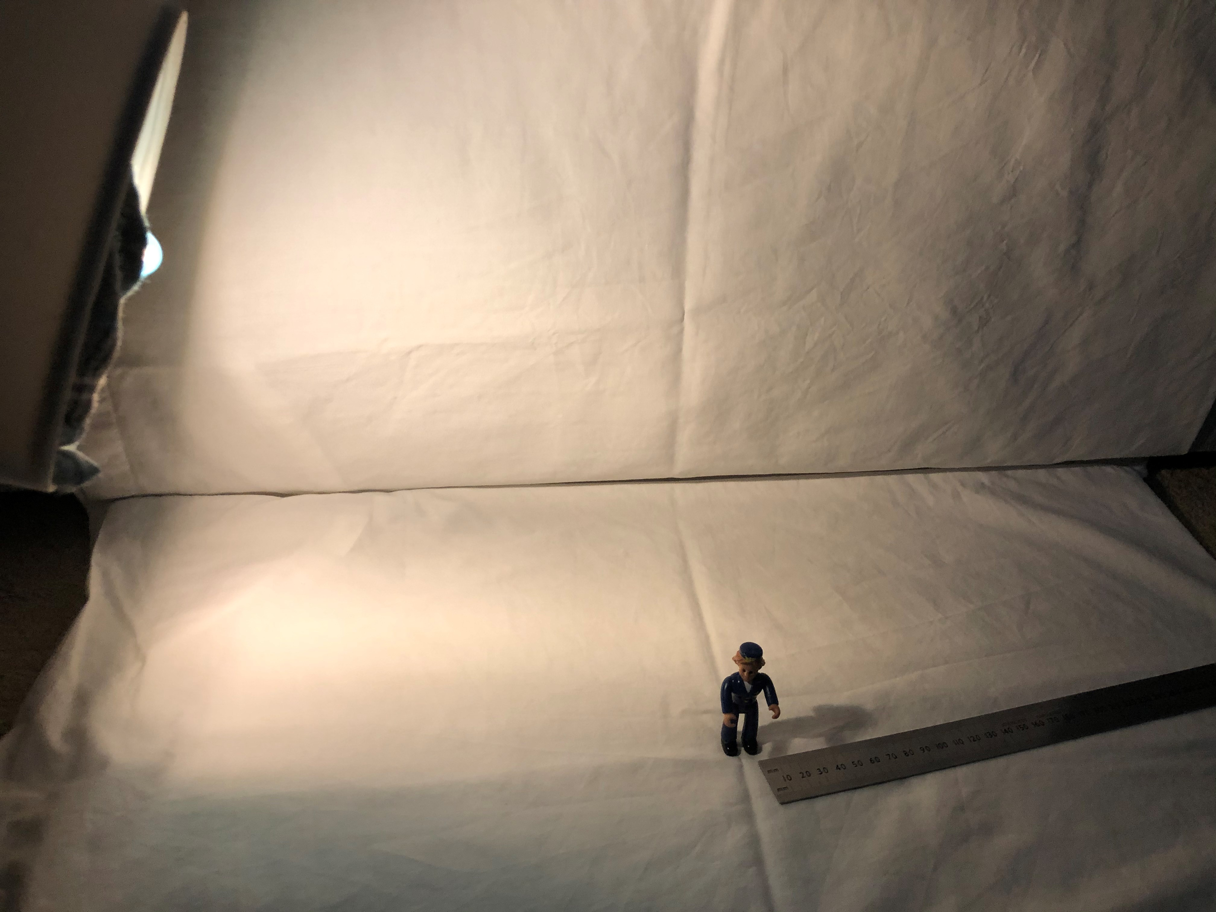
8am
Raise your torch to around 8am
Use your ruler to measure the length of the shadow
8am

Slide 12
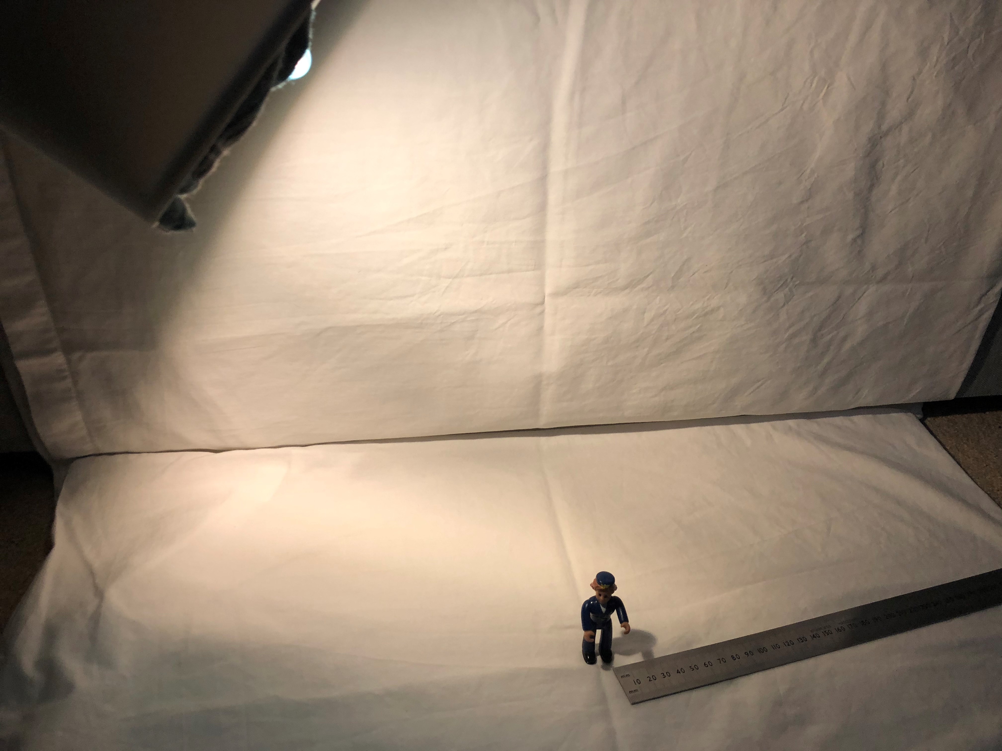
10am
Raise your torch to around 10am
Use your ruler to measure the length of the shadow
10am

Slide 13
Measure the shadow when the torch (Sun) is in each position.
Time | Shadow Length (in cm)
Sunrise (6am)
8am
10am
Midday (12pm)
2pm
4pm
Sunset (6pm)

Slide 14
Plot a line graph of your results
30
25
Length
of
Shadow
(in cm)
20
15
10
5
6am
8am
10am
12pm
2pm
4pm
6pm
Time

Slide 15
Measure the shadow when the torch (Sun) is in each position.
Time | Shadow Length (in cm)
Sunrise (6am) | 30cm
8am | 16cm
10am | 5cm
Midday (12pm) | 1cm
2pm | 5cm
4pm | 16cm
Sunset (6pm) | 30cm

Slide 16
Plot a line graph of your results
30
25
Length
of
Shadow
(in cm)
20
15
10
5
6am
8am
10am
12pm
2pm
4pm
6pm
Time

Slide 17
Tomorrow when you come to school look where the Sun is. Then look where it is when you leave school.
Can you tell which direction is East and which is West?

Slide 18

Career Focus:
Neeta Karia
Skills Development Coach
BAE Systems.
“I help people become the best they can be”
Neeta’s job is to help people continue to learn even while working. This also means helping them to adjust to working nights or away from home.
Notes:
Images of the Solar System from Webb here: Image Archive: Solar System |ESA/Webb (esawebb.org)

